Slide 1
Probability and Statistics
Willard Williamson
Adjunct Professor
iSchool, Syracuse University
linkedin.com/in/ncc-1701-d

Slide 2
Credits
Thanks to the openintro.org project for providing lecture slides
Thanks to St. Francis Xavier University for lecture slides on the uniform distribution: http://people.stfx.ca/jquinn/STAT%20231/Class%20Power%20points/Lecture%209%20Uniform%20and%20normal%20distributions.ppt
A nice review on joint, marginal, and conditional probability: https://sites.nicholas.duke.edu/statsreview/jmc/

Slide 3
Objectives
Review of common probability concepts
Not an exhaustive survey
Highly recommended to take a probability and statistics class
Probability and statistics is very important to data scientists

Slide 4
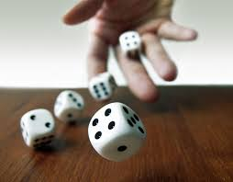
What is Probability
Probability is a measure of uncertainty
We can try to compute the probability of almost any event
An event is the basic element to which probability can be applied
Events:
An observation or the result of an experiment
like heads vs. tails
A description of a potential outcome
Notes:
https://www.google.com/url?sa=i&source=images&cd=&ved=2ahUKEwj5uemno4XjAhVuTd8KHX8MCewQjRx6BAgBEAU&url=https%3A%2F%2Fspikeybits.com%2F2016%2F12%2Fmake-your-own-dice-roller-for-around-3-tutorial.html&psig=AOvVaw2XLa_5PMPUIwGSfumulC-I&ust=1561573812436822

Slide 5
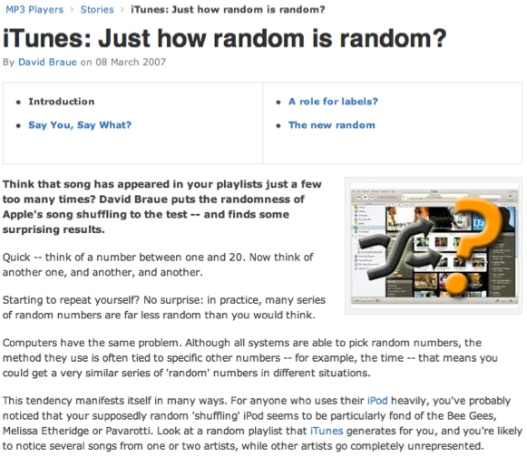
Random processes
A random process is a situation in which we know what outcomes could happen, but we don't know which particular outcome will happen.
Examples: coin tosses, die rolls, iTunes shuffle, whether the stock market goes up or down tomorrow, etc.
It can be helpful to model a process as random even if it is not truly random.
https://www.cnet.com/tech/services-and-software/itunes-just-how-random-is-random/

Slide 6
Probability
There are several possible interpretations of probability but they (almost) completely agree on the mathematical rules probability must follow.
P(A) = Probability of event A
0 ≤ P(A) ≤ 1

Slide 7
Two Views on Statistical Learning
Bayesian statistics
Frequentist Statistics
Notes:
In this course, we will use frequentist statistics (MLE), which is sometimes much easier to apply than Bayesian statistics but has some theoretical weaknesses.

Slide 8
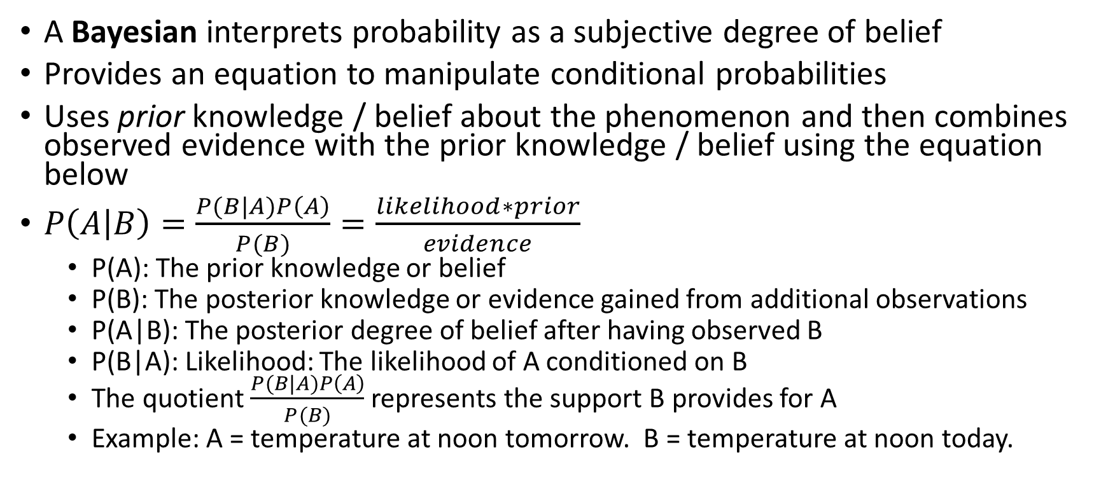
Bayesian
A Bayesian interprets probability as a subjective degree of belief
Provides an equation to manipulate conditional probabilities
Uses prior knowledge / belief about the phenomenon and then combines observed evidence with the prior knowledge / belief using the equation below
$P\left(A | B\right)=\frac{P(B|A)P\left(A\right)}{P(B)}=\frac{likelihood∗prior}{evidence}$
P(A): The prior knowledge or belief
P(B): The posterior knowledge or evidence gained from additional observations
P(A|B): The posterior degree of belief after having observed B
P(B|A): Likelihood: The likelihood of A conditioned on B
The quotient $\frac{P(B|A)P\left(A\right)}{P(B)}$ represents the support B provides for A
Example: A = temperature at noon tomorrow. B = temperature at noon today.
Notes:
In this course, we will use frequentist statistics (MLE), which is sometimes much easier to apply than Bayesian statistics but has some theoretical weaknesses.

Slide 9
Frequentist
Frequentist statistics:
The probability of an outcome is the proportion of times the outcome would occur if we observed the random process an infinite number of times.
Makes an estimate of a parameter based on sample data.
It assumes a procedure where samples from the same population will be observed an infinite number of times.
It uses sampling with replacement
The samples build the distribution
We will use the frequentist interpretation in IST-718
Notes:
In this course, we will use frequentist statistics (MLE), which is sometimes much easier to apply than Bayesian statistics but has some theoretical weaknesses.

Slide 10
Disjoint and non-disjoint outcomes
Disjoint (mutually exclusive) outcomes: Cannot happen at the same time.
The outcome of a single coin toss cannot be a head and a tail.
A student both cannot fail and pass a class.
A single card drawn from a deck cannot be an ace and a queen.

Slide 11
Disjoint and non-disjoint outcomes
Disjoint (mutually exclusive) outcomes: Cannot happen at the same time.
The outcome of a single coin toss cannot be a head and a tail.
A student both cannot fail and pass a class.
A single card drawn from a deck cannot be an ace and a queen.
Non-disjoint outcomes: Can happen at the same time.
A student can get an A in Stats and A in Econ in the same semester.

Slide 12
Probability Distributions

Slide 13
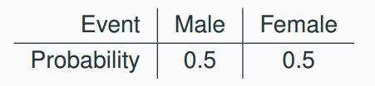
Probability distributions
A probability distribution lists all possible events and the probabilities with which they occur.
The probability distribution for the gender of one kid:

Slide 14
Probability distributions
A probability distribution lists all possible events and the probabilities with which they occur.
The probability distribution for the gender of one kid:
Rules for probability distributions:
1. The events listed must be disjoint
2. Each probability must be between 0 and 1
3. The probabilities must total 1

Slide 15
Random Variables

Slide 16
Random variables
A random variable is a numeric quantity whose value depends on the outcome of a random event
We use a capital letter, like X, to denote a random variable
The values of a random variable are denoted with a lowercase letter, in this case x
For example, P(X = x)
There are two types of random variables:
Discrete random variables often take only integer values
Example: Number of credit hours, Difference in number of credit hours this term vs last
Continuous random variables take real (decimal) values
Example: Cost of books this term, Difference in cost of books this term vs last

Slide 17
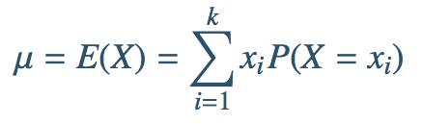
Expectation
We are often interested in the average outcome of a random variable.
We call this the expected value (mean), and it is a weighted average of the possible outcomes

Slide 18
Expected value
of a discrete random variable
In a game of cards you win $1 if you draw a heart, $5 if you draw an ace (including the ace of hearts), $10 if you draw the king of spades, and nothing for any other card you draw. Write the probability model for your winnings, and calculate your expected winning.

Slide 19
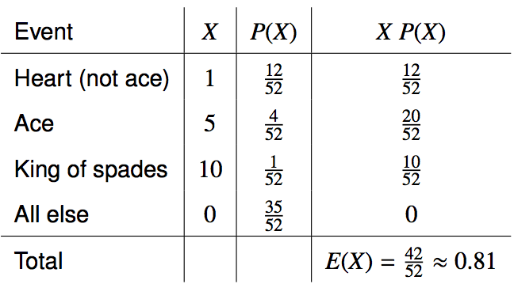
Expected value
of a discrete random variable
In a game of cards you win $1 if you draw a heart, $5 if you draw an ace (including the ace of hearts), $10 if you draw the king of spades and nothing for any other card you draw. Write the probability model for your winnings, and calculate your expected winning.

Slide 20
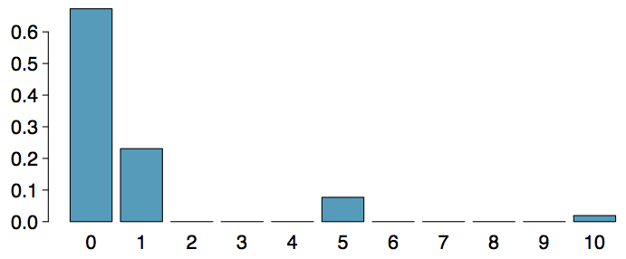
Expected value
of a discrete random variable (cont.)
Below is a visual representation of the probability distribution of winnings from this game:

Slide 21

Variance
Variance is roughly the average squared deviation from the mean.

Slide 22
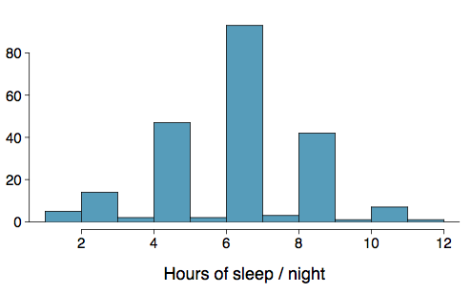
Variance
Variance is roughly the average squared deviation from the mean.
Calculate the variance for student sleep

Slide 23

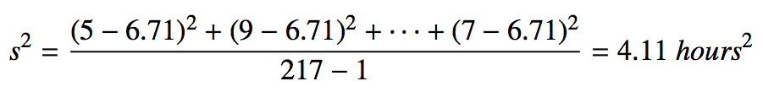
Variance
Variance is roughly the average squared deviation from the mean.
Calculate the variance for student sleep
The sample mean is and the sample size is n = 217.
The variance of amount of sleep students get per night can be calculated as:

Slide 24
Variance (cont.)
Why do we use the squared deviation in the calculation of variance?

Slide 25
Variance (cont.)
Why do we use the squared deviation in the calculation of variance?
To get rid of negatives so that observations equally distant from the mean are weighed equally.
To weigh larger deviations more heavily.

Slide 26

Standard Deviation
The standard deviation is the square root of the variance, and has the same units as the data.

Slide 27
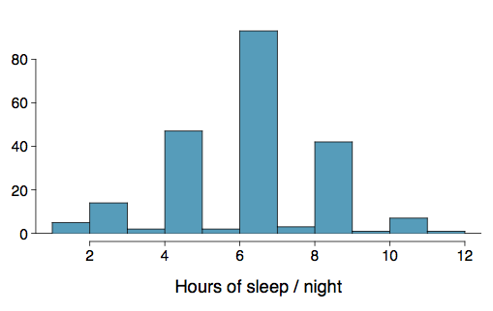

Standard Deviation
The standard deviation is the square root of the variance, and has the same units as the data.
The standard deviation of amount of sleep students get per night can be calculated as:

Slide 28
Standard Deviation
The standard deviation is the square root of the variance, and has the same units as the data.
The standard deviation of amount of sleep students get per night can be calculated as:
We can see that all of the data are within 3 standard deviations of the mean.

Slide 29
Normal distribution

Slide 30
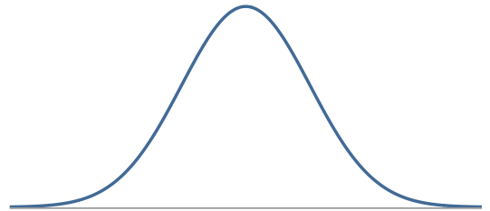
Normal Distribution
Unimodal and symmetric, bell shaped curve
Many variables are nearly normal, but none are exactly normal
Denoted as N(µ, σ) → Normal with mean µ and standard deviation σ

Slide 31
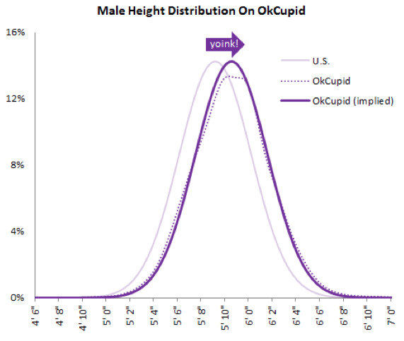
Heights of males

Slide 32
Heights of males
“The male heights on OkCupid very nearly follow the expected normal distribution -- except the whole thing is shifted to the right of where it should be. Almost universally guys like to add a couple inches.”
“You can also see a more subtle vanity at work: starting at roughly 5' 8", the top of the dotted curve tilts even further rightward. This means that guys as they get closer to six feet round up a bit more than usual, stretching for that coveted psychological benchmark.”
http://blog.okcupid.com/index.php/the-biggest-lies-in-online-dating

Slide 33
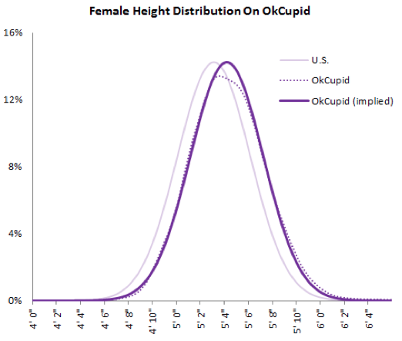
Heights of females
“When we looked into the data for women, we were surprised to see height exaggeration was just as widespread, though without the lurch towards a benchmark height.”
http://blog.okcupid.com/index.php/the-biggest-lies-in-online-dating

Slide 34
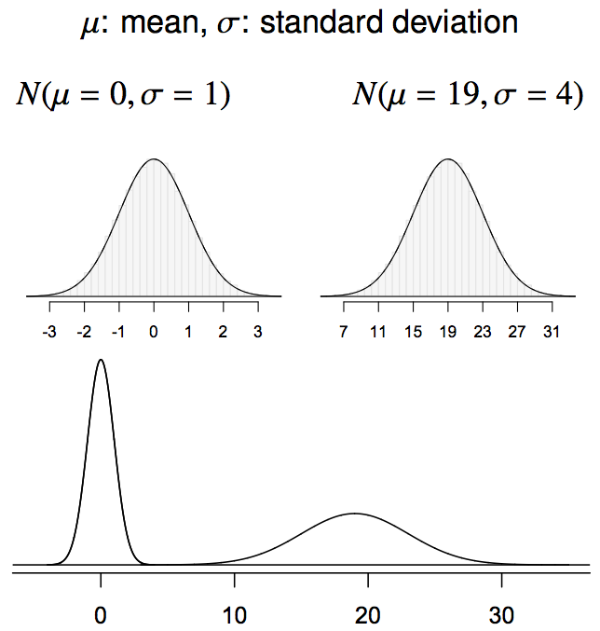
Normal distributions with different parameters

Slide 35
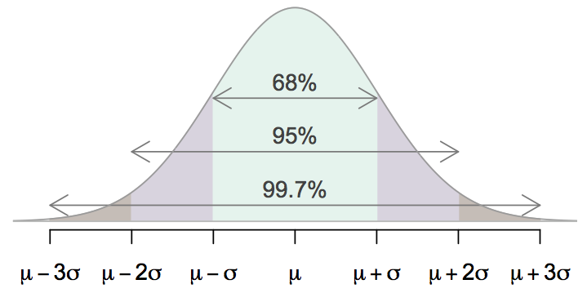
68-95-99.7 Rule
For nearly normally distributed data,
about 68% falls within 1 SD of the mean,
about 95% falls within 2 SD of the mean,
about 99.7% falls within 3 SD of the mean.
It is possible for observations to fall 4, 5, or more standard deviations away from the mean, but these occurrences are very rare if the data are nearly normal.

Slide 36
Describing variability using the 68-95-99.7 Rule
SAT scores are distributed nearly normally with mean 1500 and standard deviation 300.

Slide 37
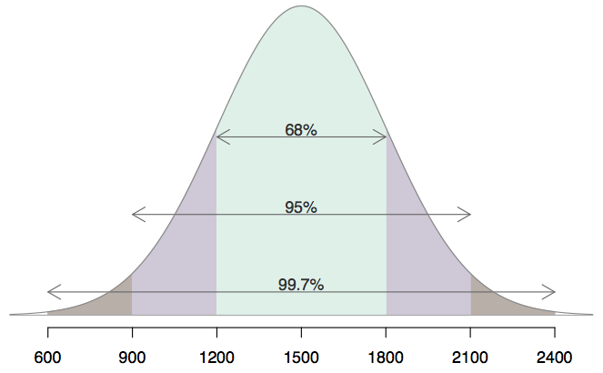
Describing variability using the 68-95-99.7 Rule
SAT scores are distributed nearly normally with mean 1500 and standard deviation 300.
~68% of students score between 1200 and 1800 on the SAT.
~95% of students score between 900 and 2100 on the SAT.
~$99.7% of students score between 600 and 2400 on the SAT.

Slide 38
Uniform Distribution

Slide 39
Uniform Distribution
A Uniform Distribution has equally likely values over the range of possible outcomes.
A graph of the uniform probability distribution is a rectangle with area equal to 1.

Slide 40
Example
The figure below depicts the probability distribution for temperatures in a manufacturing process. The temperatures are controlled so that they range between 0 and 5 degrees Celsius, and every possible temperature is equally likely.
P(x)
0.2
0
x
0 1 2 3 4 5
Temperature (degrees Celsius)

Slide 41
General Uniform Distribution
A Uniform Distribution has equally likely values over the range of possible outcomes, say c to d (x axis ranges from c to d).

Slide 42
Sampling

Slide 43
Population
Population: A population is an entire collection of objects or individuals about which information is desired.
Populations are often hard to measure exactly.
If we want to measure the percentage of Trump voters in the United States, the population is all eligible voters in the United States.
Some populations are known in their entirety.
If we want to know the percentage of female employees at Lockheed in Liverpool, the population is all Lockheed Liverpool employees

Slide 44
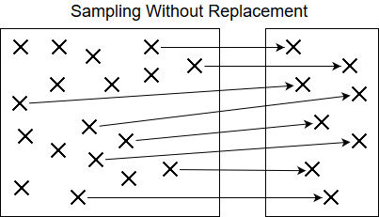
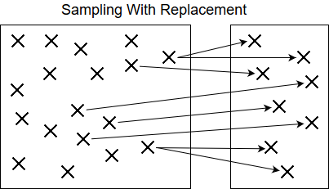
Sampling
What do we do if the population is too large to work with: Like the United states population?
Sample: A sample is a subset of a population.
Ex: A sample of 1000 prospective voters for the Trump vs. Clinton election
Samples can be drawn from a population with or without replacement.
Sampling with or without replacement depends on context
Notes:
Example with replacement: Sampling for boosting / bootstrap

Slide 45


Sampling Continued …
The process of sampling is a natural process, we do it in our everyday lives …
If you walked into an unfamiliar store and wanted to determine if the store was expensive or not, you would not check every price in the store; but rather, you would check the prices of a variety of items.
If you are cooking a batch of spaghetti sauce and wanted to check the quality, you would taste a small sample instead of the entire batch.

Slide 46
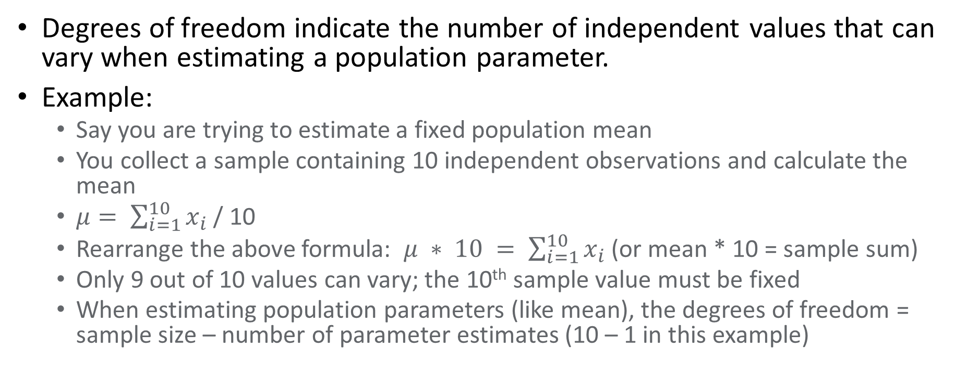
Degrees of Freedom
Degrees of freedom indicate the number of independent values that can vary when estimating a population parameter.
Example:
Say you are trying to estimate a fixed population mean
You collect a sample containing 10 independent observations and calculate the mean
$μ= \sum_{i=1}^{10}{x_{i}}$ / 10
Rearrange the above formula: $μ ∗ 10 = \sum_{i=1}^{10}{x_{i}}$ (or mean * 10 = sample sum)
Only 9 out of 10 values can vary; the 10th sample value must be fixed
When estimating population parameters (like mean), the degrees of freedom = sample size – number of parameter estimates (10 – 1 in this example)

Slide 47
Bessel’s Correction
Bessel was a French Mathematician
Bessel’s Correction uses the notion of degrees of freedom to improve the estimate of population variance when estimated from sample data.
Math Fact: Sample variance is always less than or equal to population variance (assuming sampling with replacement).
Bessel’s correction: Subtracting 1 from the number of sample observations in the variance formula produces a better estimate of the population variance.
See: https://en.wikipedia.org/wiki/Bessel%27s_correction

Slide 48
Covariance
Covariance measures the linear relationship between 2 random variables.
Positive covariance means as X increases, Y also increases
Negative covariance means as X increases, Y decreases
Does have units, ranges from + infinity to - infinity
Not normalized so it’s hard to tell the degree of co-variation based on the resulting number.
The sign is what matters when interpreting covariance

Slide 49
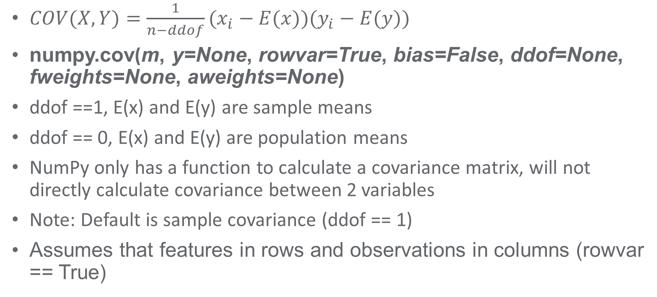
Covariance Continued …
$COV(X,Y)=\frac{1}{n−ddof}(x_{i}−E(x))(y_{i}−E(y))$
numpy.cov(m, y=None, rowvar=True, bias=False, ddof=None, fweights=None, aweights=None)
ddof ==1, E(x) and E(y) are sample means
ddof == 0, E(x) and E(y) are population means
NumPy only has a function to calculate a covariance matrix, will not directly calculate covariance between 2 variables
Note: Default is sample covariance (ddof == 1)
Assumes that features in rows and observations in columns (rowvar == True)

Slide 50
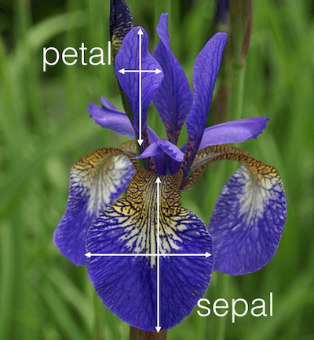
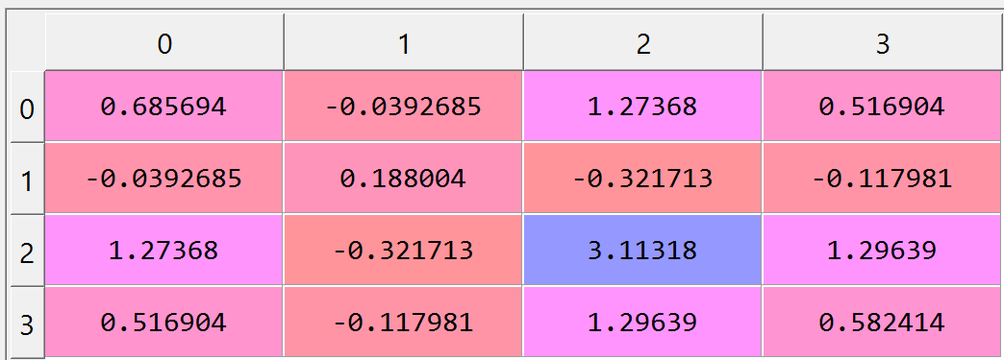
Iris Data Covariance Matrix Example
Iris Dataset comes from Statistician Ronald Fisher in 1936
Covariance matrix for Iris data set.
Cols: Sepal Length, Sepal Width, Petal Length and Petal Width
Rows: Sepal Length, Sepal Width, Petal Length and Petal Width
Diagonal represents variance. For example, matrix[0][0] is sepal length variance

Slide 51
Correlation Coefficient
Correlation measures the linear relationship between 2 random variables.
Dimensionless (no units)
Ranges from -1 to 1 where the absolute correlation suggests the degree of correlation.
Size and sign matters
+1 is perfect positive correlation, -1 is perfect negative correlation, 0 is completely uncorrelated.

Slide 52
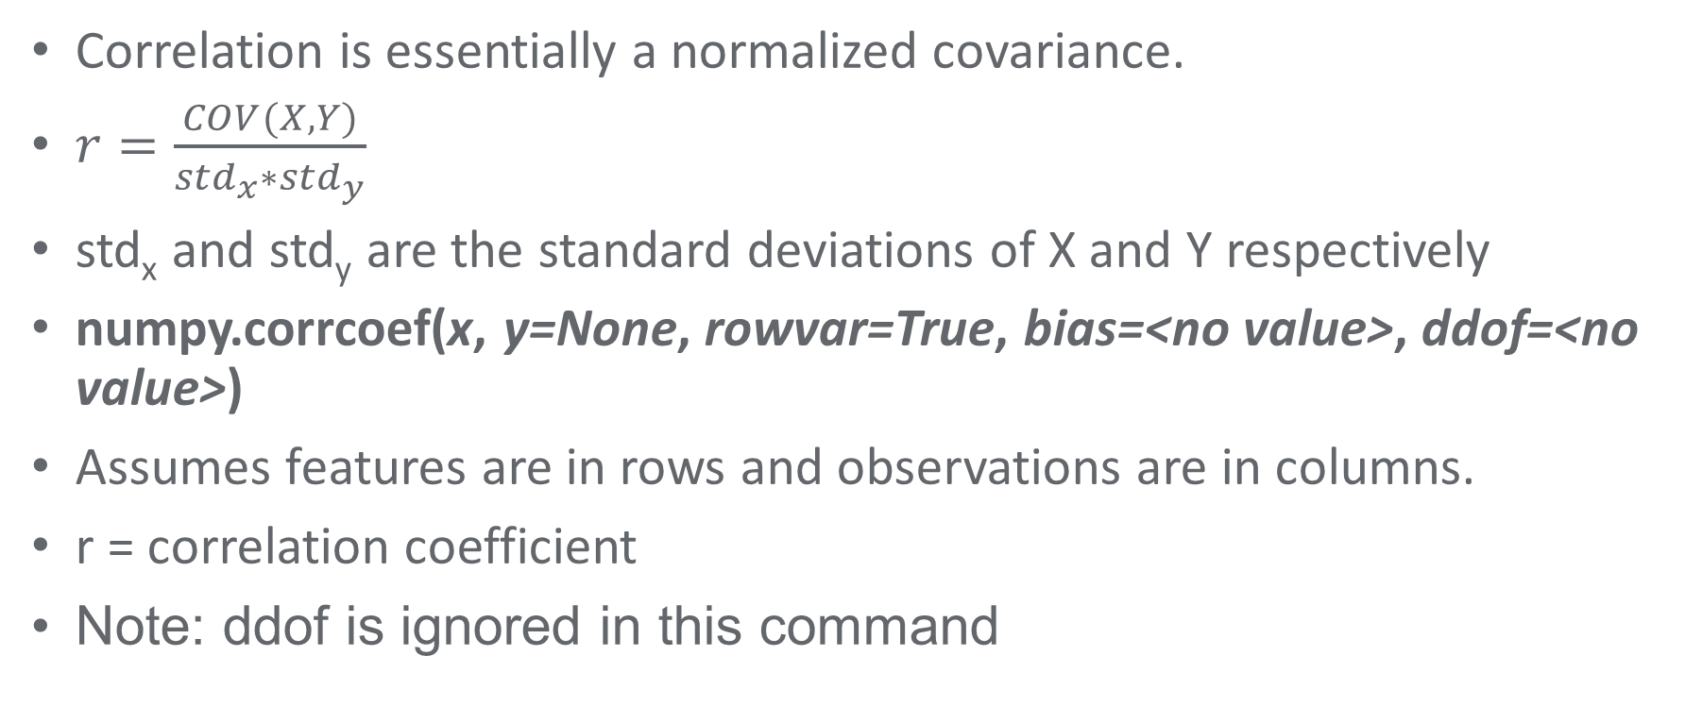
Correlation Continued
Correlation is essentially a normalized covariance.
$r=\frac{COV(X,Y)}{{std}_{x}∗{std}_{y}}$
std_{x} and std_{y} are the standard deviations of X and Y respectively
numpy.corrcoef(x, y=None, rowvar=True, bias=<no value>, ddof=<no value>)
Assumes features are in rows and observations are in columns.
r = correlation coefficient
Note: ddof is ignored in this command

Slide 53

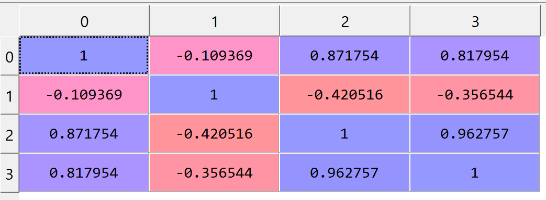
Iris Data Correlation Matrix Example
Correlation matrix for Iris dataset
Cols: Sepal Length, Sepal Width, Petal Length and Petal Width
Rows: Sepal Length, Sepal Width, Petal Length and Petal Width
Assumes that features in rows and observations in columns (rowvar == True)

Slide 54
Correlation Rules of Thumb
Correlation Magnitude | Interpretation
0.00 – 0.20 | Very Weak
0.20 – 0.40 | Weak to Moderate
0.40 – 0.60 | Medium to Substantial
0.60 – 0.80 | Very Strong
0.80 – 1.00 | Extremely Strong

Slide 55
Correlation / Covariance Summary
Covariance provides the direction of a linear relationship between 2 variables
Correlation provides the direction and strength of a linear relationship between 2 variables
Covariance has units and ranges from negative infinity to positive infinity
Correlation is unitless and ranges from -1 to +1
Both can provide misleading results if provided with outliers or non linear data
Both provide a measure of association, not causation

Slide 56
Central Limit Theorem (CLT)
The Central Limit Theorem is possibly the most important theorem in all of Statistics
CLT is certainly the most important theorem for statisticians and very important in general to data scientists
The CLT states that if random samples of size n are repeatedly drawn (with replacement) from any population with mean µ and variance σ2 , then when n is large, the distribution of the sample means will follow the characteristics of a normal distribution

Slide 57
CLT Assumptions
How large does the sample need to be?
A common rule of thumb is n >= 30 for ANY population distribution
Use n >= 15 if the population distribution is symmetric
If the population follows a normal distribution, then n can be any size
Samples must be independent (sample with replacement)
Samples must be identically distributed
As sample size increases, the resulting sample distribution of the mean will more closely approximate a normal distribution.

Slide 58
CLT Summary
CLT is very powerful because it provides us with a tool to transform any population distribution into a normal distribution
Once transformed into a normal distribution, operations can be performed using the well-known Gaussian distribution
See CLT demo code in the numpy tutorial notebook.

